Slide 1
Value of Genetics, Net Merit, Base Change
Dr. John B. Cole
National DHIA Annual Meeting | March 5, 2025

Slide 2
Topics for discussion
April 2025 Net Merit Update
April 2025 Base Change
Genetic Evaluations of Foot/Claw Health and Mobility
The Future of Net Merit

Slide 3
Net Merit

Slide 4
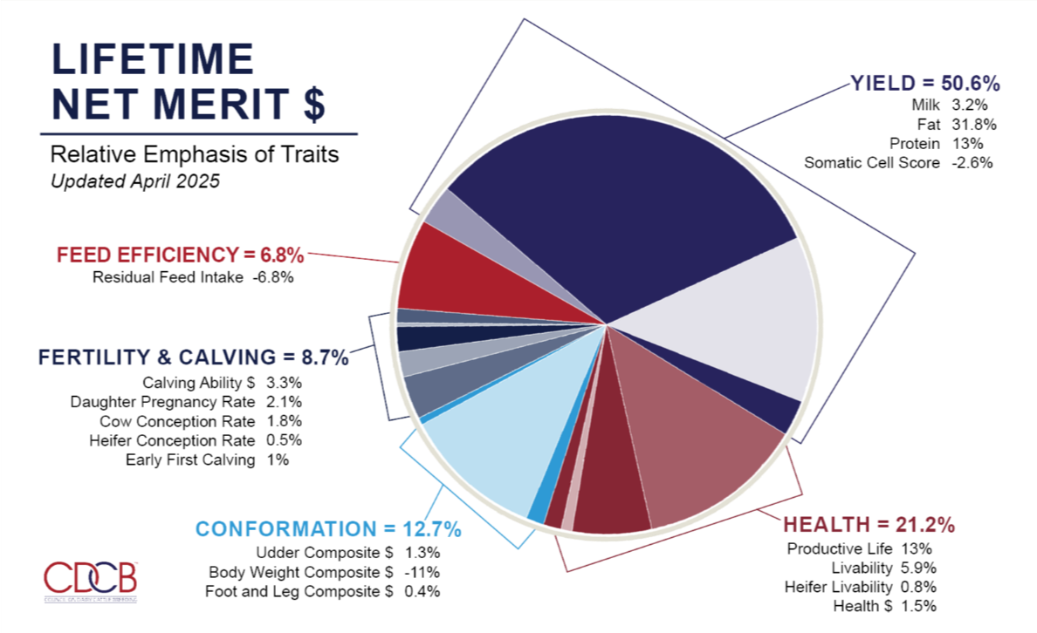

Slide 5
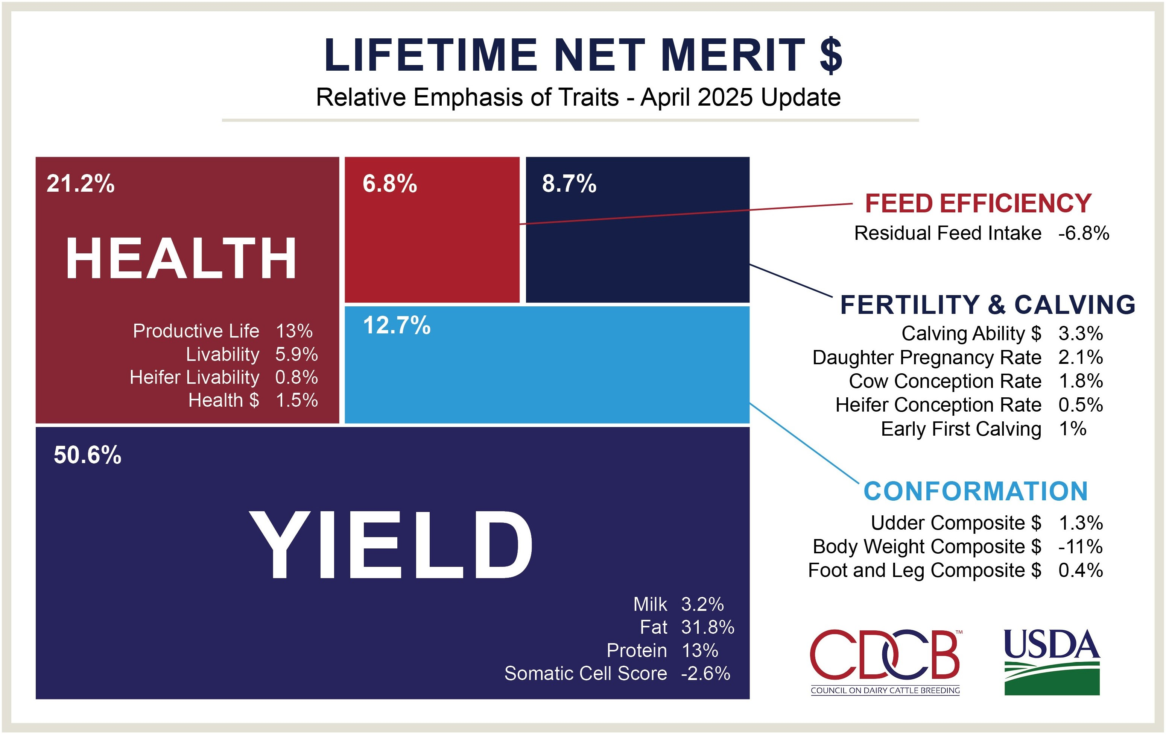

Slide 6
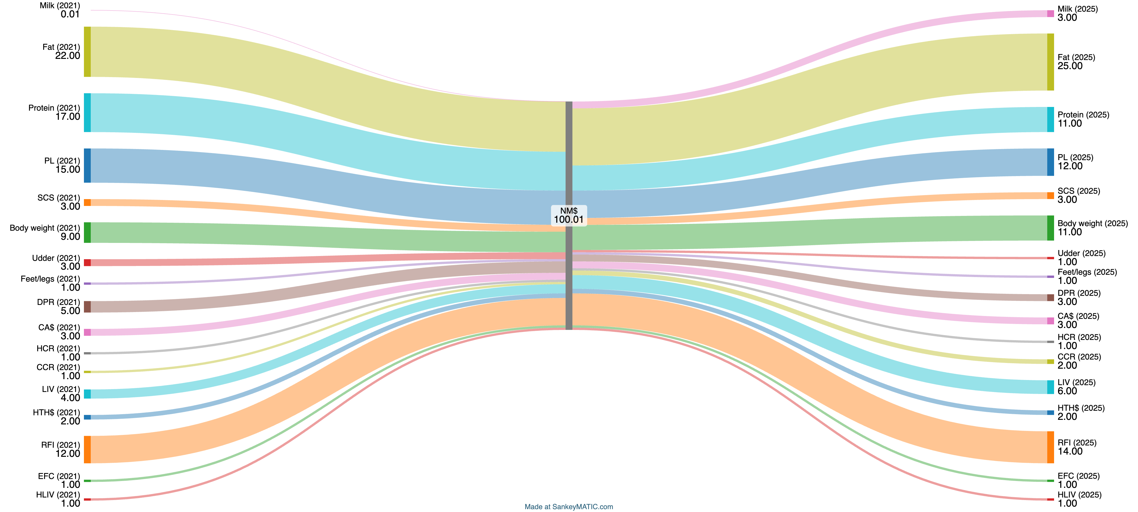
Changes from 2021 to 2025 were small

Slide 7
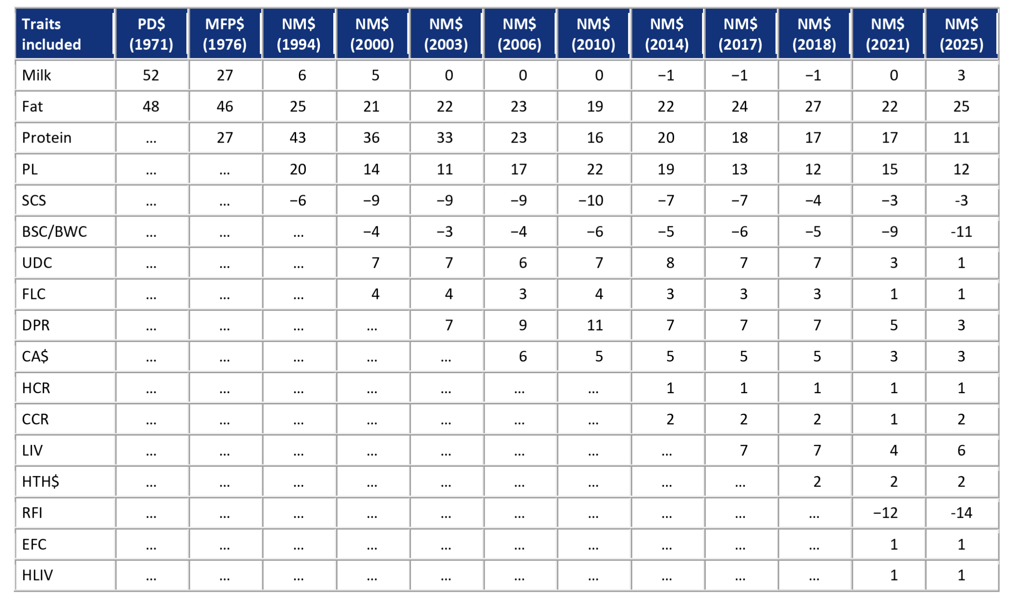
Net merit is always evolving

Slide 8
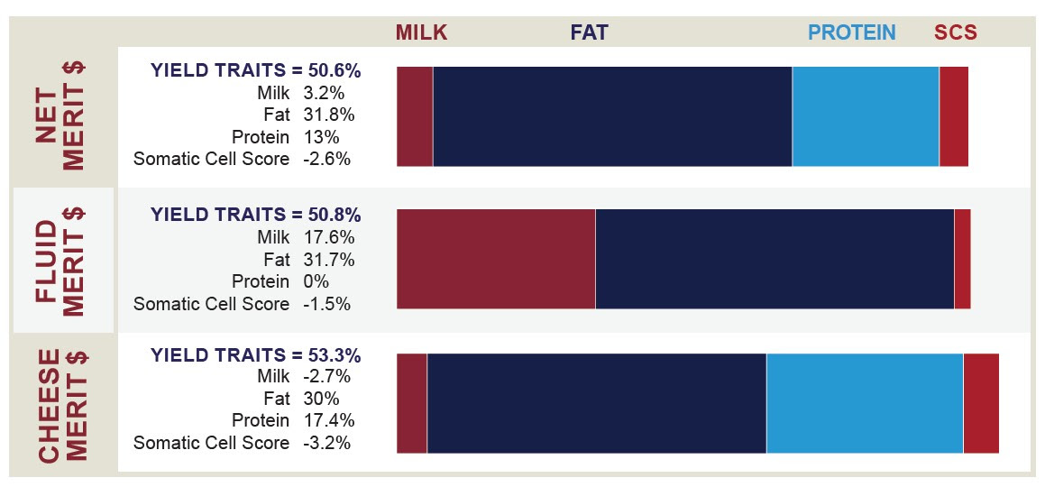
Which index matches your milk check?

Slide 9
Genetic trend for NM$ is strong!

Slide 10
Base Change

Slide 11
What is a base change?
The base is a reference point for measuring genetic progress.
The average PTAs of cows born in a specific year are set to zero (the starting line from which we measure genetic progress).
In April 2025, the genetic base will move from cows born in 2015 to cows born in 2020. Routine base adjustments allow new evaluations to be easily compared with previous evaluations.
A bull or cow that previously met selection standards may not do so in April due to the base change.

Slide 12
How is the base change calculated?
Changes greater than 0 mean the younger cows have a higher genetic merit than the older cows.
April 2025 PTAs will show the inverse effect (i.e., a positive milk value in the chart below will result in a decrease in milk PTA in April).
Average PTA (cows born in 2020) – Average PTA (cows born in 2015) Base Change

Slide 13
2025 base change (selected traits)
Trait | Ayrshire | Brown Swiss | Guernsey | Holstein | Jersey | Milking Shorthorn
Milk | 150 | 350 | 75 | 750 | 400 | 10
Fat | 5 | 10 | 0 | 45 | 20 | -5
Protein | 5 | 15 | 5 | 30 | 15 | 0
Somatic Cell Score | 0 | 0 | 0 | -0.1 | 0 | 0
Productive Life | 0 | 1 | 1 | 2.5 | 1.5 | 0.5
Cow Livability | -1 | 0.5 | 0 | 0.5 | 0.5 | 0
Heifer Livability | – | – | – | 0.5 | 0.2 | –
Daughter Pregnancy Rate | -1 | -0.6 | -0.5 | -0.2 | -0.4 | -0.5
Heifer Conception Rate | -.05 | 0.1 | -0.5 | 1 | 1.5 | -0.5
Cow Conception Rate | -1 | -0.5 | -1 | 0.5 | 0 | -0.5
Early First Calving | -0.5 | 0.5 | 0.2 | 2 | 2 | -1.5
Sire Calving Ease | – | 0.1 | – | -1 | – | –
Daughter Calving Ease | – | 0 | – | -0.5 | – | –
Sire Stillbirth | – | – | – | -2 | – | –
Daughter Stillbirth | – | – | – | -1 | – | –
Ketosis | – | ** | – | 1 | -0.1 | –
Mastitis | – | -0.2 | – | 0.75 | -1 | –
Metritis | – | ** | – | 1 | 0 | –
Residual Feed Intake | – | – | – | -40 | – | –

Slide 14
Genetic Evaluations for Foot/Claw Health and Mobility

Slide 15

Multiple potential data sources
UMN collaboration
DRPC lesion data
CattleEye
Producer-reported to NCD
UMN collaboration – collecting lesion data reported by trained trimmers
Most also includes associated CattleEye data
CattleEye data - mobility scores collected autonomously by a video analytics platform, providing a score ranging from 1 to 100, with a threshold of 50 indicating a possible mobility problem
DRPC lesion data – lesion data collected within farm management software that are provided to the DRPC (research)
Producer-reported to NCD – reported ”LAME” through Format 6 sent by DRPCs

Slide 16
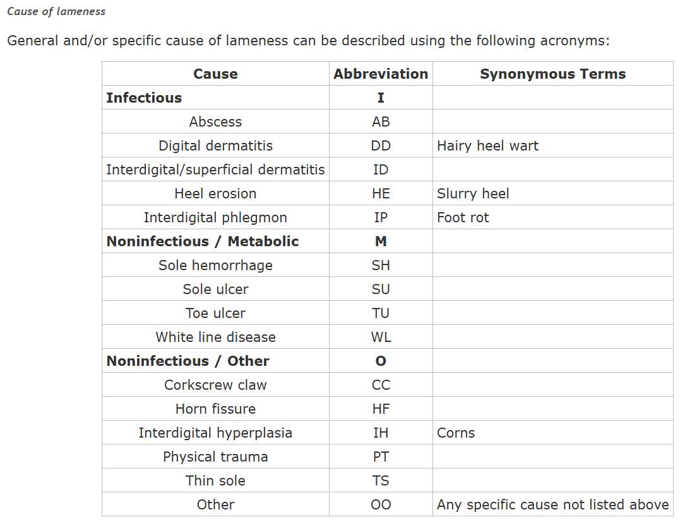
Lameness vs Lesions vs Mobility
Target trait is lameness – what’s the ‘optimal’ measure of lameness?
Cause: Lesion Incidence
Producer reported, hoof trimmer records
Format 6
Infectious
Metabolic (noninfectious)
Other (noninfectious)
Binary Measure
Clear biological basis and interpretation
Labor intensive to collect
Notes:
Slide from Ashley

Slide 17
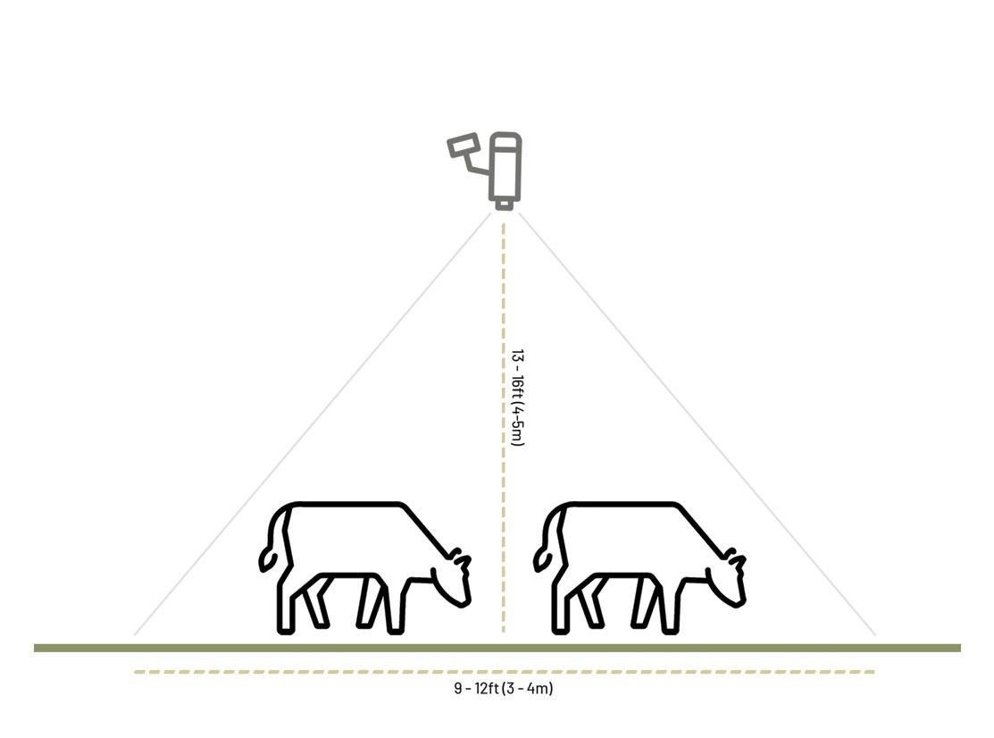
Lameness vs Lesions vs Mobility
Target trait is lameness – what’s the ‘optimal’ measure of lameness?
Effect: Mobility Scores
Continuous measure of difficulty walking
0 – ‘Perfect’ gait
100 – Extreme difficulty walking
Automated data collection – CattleEye
May capture non-lesion causes of lameness that may be otherwise difficult to characterize
Increase in mobility score may not always reflect full severity of issue
Notes:
Slide from Ashley

Slide 18
Lesion Data

Slide 19
DRMS lesion data received
Total records submitted: n = 721,209
Number of herds: n = 830
Number of cow records: n = 719,170
Event dates ranging from 2002 to 2024
Animals that saw the trimmer with(out) lesions
Lesions included:
Abscess
Erosion heel
Interdigital dermatitis
Non-foot, upper-leg
Thin sole
Corkscrew claw
Foot rot
Korn
Other
Ulcer
Digital dermatitis / heel wart
Sole hemorrhage
Laminitis
White line / separation
Vertical / sand cracks

Slide 20
Matching with the National Cooperator Database
Total records with matching cow control number and herd-year lactation record in NCD: n = 549,994
For subsequent analyses, healthy contemporary herd mates based on herd-year were extracted from NCD

Slide 21
Digital dermatitis
Most reported lesion within dataset
Total records after merging with NCD: n = 568,302
Overall lactation incidence: 6.4%
Number of unique cows: n = 304,307
Most prevalent breeds represented: HO, JE, XX
97% of records included in parities 1 to 5

Slide 22
Example: Digital dermatitis
Threshold animal model with same effects as current CDCB health evaluations
Heritability = 9.0% (SD = 0.006)
Linear animal model with same effects as current CDCB health evaluations
Heritability = 2.7%

Slide 23
Mobility

Slide 24
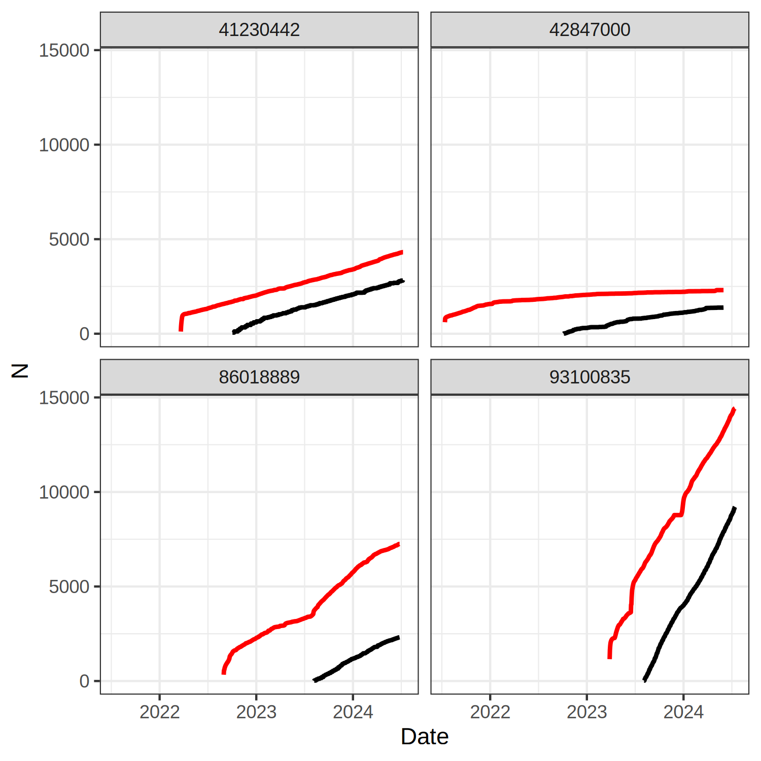
CattleEye Availability
Cumulative number of cow-parities with a CattleEye (red) or trimmer (black) record per herd
4 herds
Earliest record 2020
34,110 cow-parities with CattleEye scores or lesion data
24,644 with CattleEye score
15,755 with trimmer record (normal or lesion)
CattleEye
Trimmer
Notes:
Ashley’s slide

Slide 25
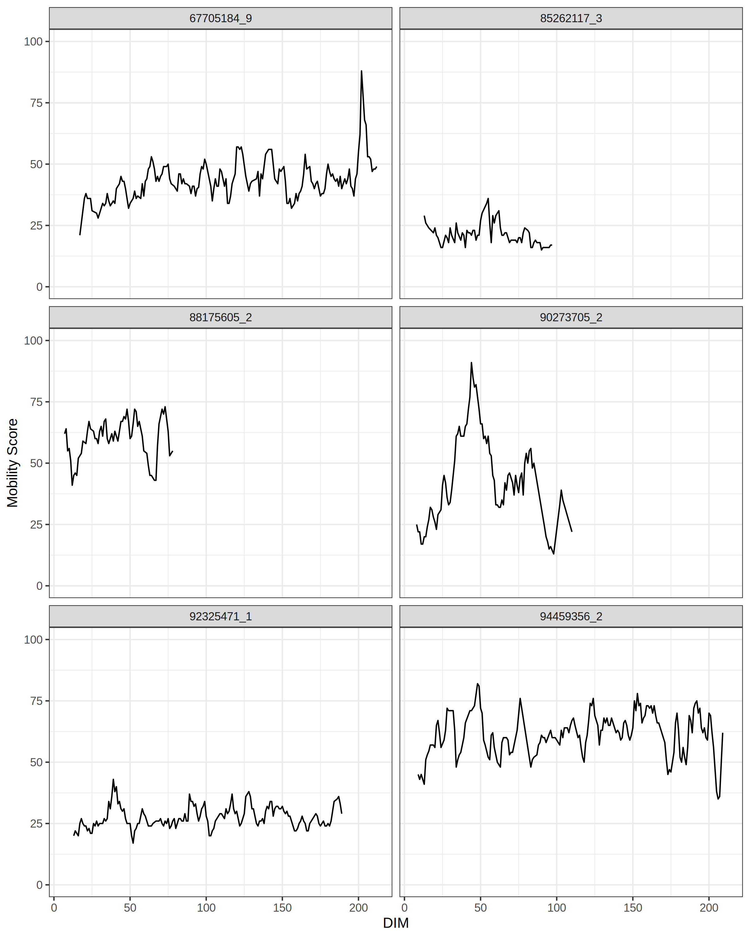
Mobility Score Dimensionality
One score per day (ideally)
Up to 294 mobility scores per lactation in current data
Highly dimensional, complex trends
Don’t tell us why the animal is lame
Identification of most important features for genetic evaluation
Notes:
Ashley’s slide

Slide 26
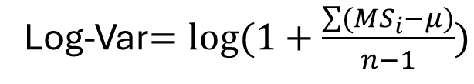

Mobility Score Dimensionality
Reducing the dimensionality
Mean
Log-Variance
Proportion of Scores Exceeding a Threshold
$$μ=\frac{\sum{{MS}_{i}}}{n}$$
Log-Var$=log⁡(1+\frac{\sum{{(MS}_{i}−μ)}}{n−1})$
Notes:
Ashley’s slide

Slide 27
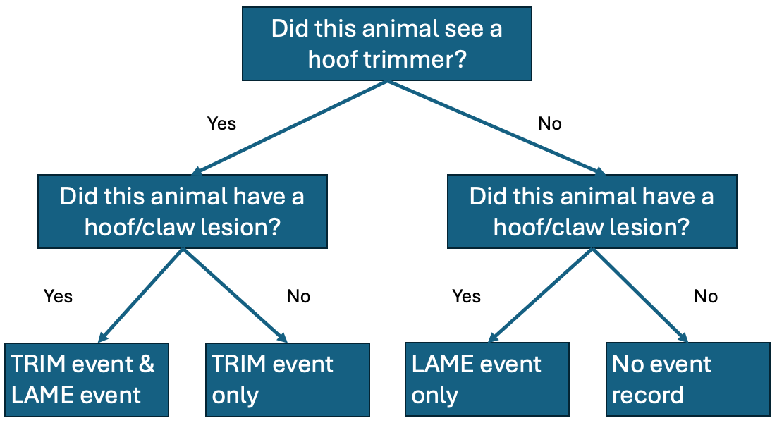
Proposed changes to Format 6

Slide 28
The Future of Net Merit

Slide 29
Ideas for future Net Merit
Emphasize trait groups instead of individual phenotypes.
Automate data collection to make it easier to model different scenarios.
Find agricultural economists interested in “accounting”.
It’s a challenge when people expect Net Merit to be something it isn’t designed to be – there’s no such thing as a “universal” index that applies everywhere.

Slide 30
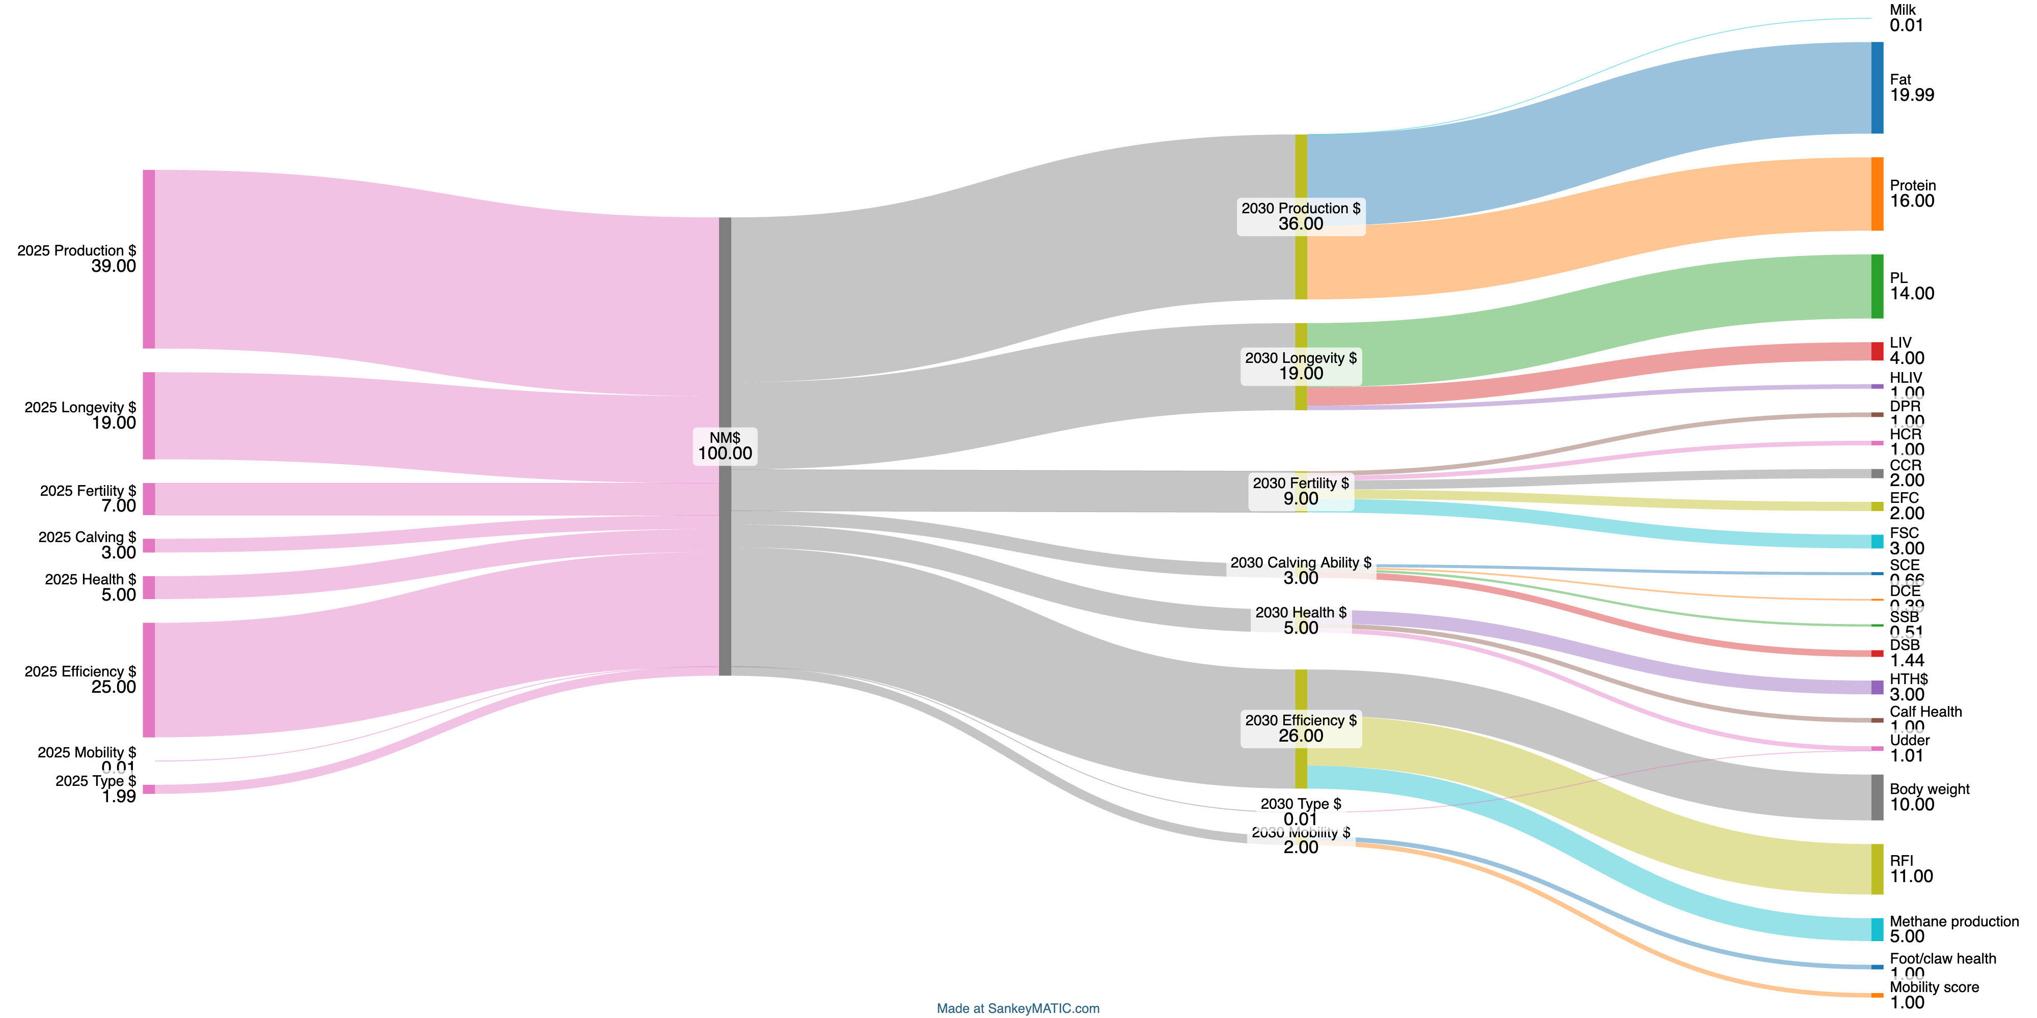

Slide 31
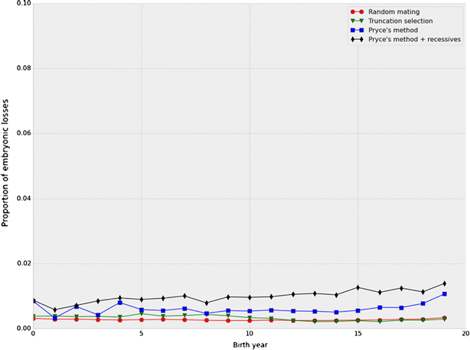
Things Net Merit isn’t good at
Managing inbreeding – that’s a mate allocation problem, not a genetic ranking one.
Reducing the frequency of undesirable recessives (see Cole, 2015).
Increasing the frequency of the polled allele in Holsteins.

Slide 32
Conclusions
Changes from 2021 to 2025 Net Merit were small.
Base change values for individual traits were similar to previous changes.
Net Merit will remain an economic index whose weights are driven by incomes and expenses as best we can measure them.

Slide 33
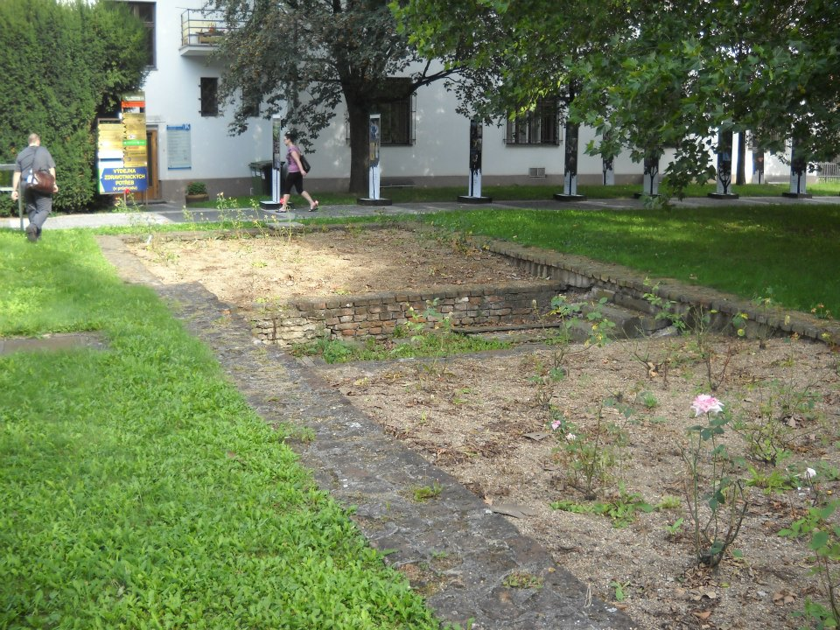
Questions?
Foundation of Gregor Mendel’s greenhouse, Brno, Czech Republic.

